Slide 1
Microsoft Azure DevCamps
Vishesh Oberoi
Software Developer, Datacom
@ovishesh
vishesho@datacom.co.nz
http://visheshoberoi.com

Slide 2
Why the cloud?
Notes:
There is this whole façade of cloud computing chatter around the tech industry
Every company, atleast all the big services companies, one like ours, is adopting it rapidly.
So we are here today at this event to talk about what it actually is that is driving all these companies to embrace the power of the cloud
While we are at it, we will try to connect the dots with this for any startup that is on the lookout for that initial kick for their dev-setup

Slide 3
Why the cloud?
Speed
Scale
Economics
Notes:
Speed - Rapidly setup environments to drive business priorities
Scale - Scale to meet peak demands
Economics - Increase daily activities, efficiency and reduced cost.

Slide 4
Why the cloud?
Hosting models
Business model
On Premises
Infrastructure
(as a Service)
Platform
(as a Service)
Software
(as a Service)
Applications
Applications
You manage
Applications
Applications
You scale, make resilient and manage
You scale, make
resilient & manage
Data
Data
Data
Data
Runtime
Runtime
Runtime
Runtime
Scale, resilience and management by vendor
Middleware
Middleware
Middleware
Scale, resilience and management by vendor
Middleware
O/S
O/S
O/S
O/S
Virtualization
Virtualization
Managed by vendor
Virtualization
Virtualization
Servers
Servers
Servers
Servers
Storage
Storage
Storage
Storage
Networking
Networking
Networking
Networking
Notes:
These are the typical and the most generalized scenarios we have available to us.. With many, many, providers.

Slide 5
Why the cloud
, for Startups?
Notes:
I don’t know why but I have a very strong feeling that most of you are pretty bored by now and thinking whether or not will this guy deliver to all the promises he had set out on the event page.. All that I have been talking about so far is something you get to hear at every single event, but then there is whole grey area around startups and why they should be embracing the benefits of cloud computing too
Benefits:
Plug and play
No need to buy the equipment
Everything from starting right from the infrastructure to management, everything can be taken care of
….
I was reading this article a couple of weeks ago about how Xero, the accounting software company, started off by using Rackspace as their Cloud provider, but now are moving over to Amazon
625 servers
729 updates to the software
Tech startups typically build their businesses with help from cloud computing services — services that provide instant access to computing power via the internet
You've got a great idea for a product and you're ready to launch it into the world. What's the best way to create the IT infrastructure that will allow you to get it out there quickly and cheaply? Contemporary wisdom says cloud computing is the way to go -- but before you go forth blindly, take a moment to assess your business needs and chose your cloud services provider very very carefully.
Its not just about easy setup and infrastructure, It's about less investment, less trouble. Those costs don't go away, but are evenly distributed, which is certainly attractive with startup companies who don't know what the future holds
Cloud-based services allow for autoscaling – very critical

Slide 6
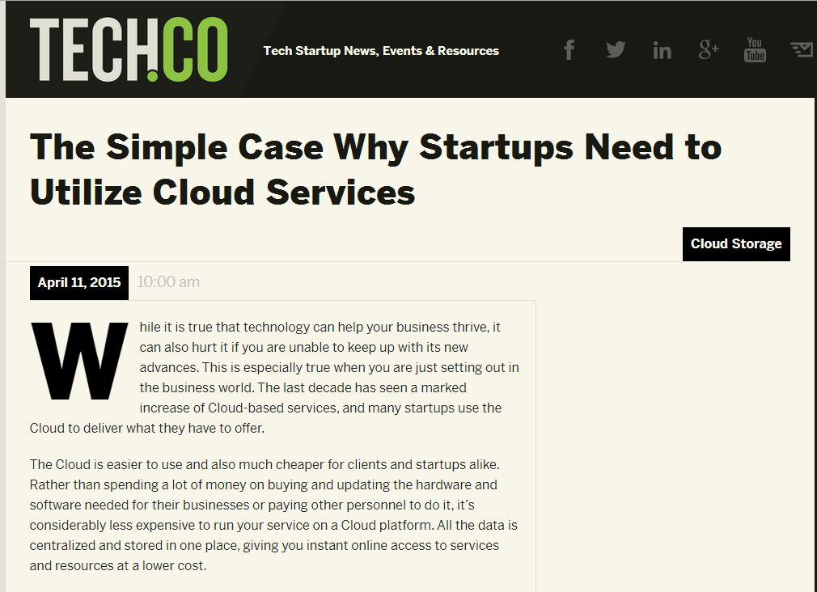
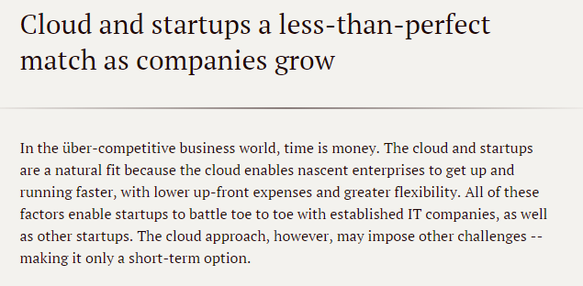
http://searchcloudcomputing.techtarget.com/feature/Cloud-and-startups-a-less-than-perfect-match-as-companies-grow
http://tech.co/simple-case-startups-need-utilize-cloud-services-2015-04
Notes:
I don’t know why but I have a very strong feeling that most of you are pretty bored by now and thinking whether or not will this guy deliver to all the promises he had set out on the event page.. All that I have been talking about so far is something you get to hear at every single event, but then there is whole grey area around startups and why they should be embracing the benefits of cloud computing too
Benefits:
Plug and play
No need to buy the equipment
Everything from starting right from the infrastructure to management, everything can be taken care of
….
I was reading this article a couple of weeks ago about how Xero, the accounting software company, started off by using Rackspace as their Cloud provider, but now are moving over to Amazon
625 servers
729 updates to the software
Tech startups typically build their businesses with help from cloud computing services — services that provide instant access to computing power via the internet
You've got a great idea for a product and you're ready to launch it into the world. What's the best way to create the IT infrastructure that will allow you to get it out there quickly and cheaply? Contemporary wisdom says cloud computing is the way to go -- but before you go forth blindly, take a moment to assess your business needs and chose your cloud services provider very very carefully.
Its not just about easy setup and infrastructure, It's about less investment, less trouble. Those costs don't go away, but are evenly distributed, which is certainly attractive with startup companies who don't know what the future holds
Cloud-based services allow for autoscaling – very critical

Slide 7



Cloud Computing
IaaS
PaaS
SaaS
Infrastructure-as-a-Service
Platform-as-a-Service
Software-as-a-Service
host
build
consume

Slide 8
Azure

Slide 9
How Azure is different?
Hyper-scale
Enterprise Grade
Hybrid

Slide 10
Microsoft Azure

Slide 11
Portal
Storage
ASP.NET MVC 5.1
Virtual Machines
SMB File System
Traffic Mgr
Disk Optimized
Memory Optimized
IBIZA
Azure Redis Cache
Hadoop 2.2
Powershell and DSC
Static IP
Resource Manager
99.95% SLA
Puppet Chef Docker
Event Hub
2014
Subnet Routing
Backup
Capture / Deploy
.NET 4.5
Web Apps
SQL Database
Powershell Automation
BD’s up to 500GB
Cordova
API Management
.NET Support
Autoscale
Active GEO replication
Node.JS project support
Self Service Site Recovery
Java Support
Remote Apps
Visual Studio & .NET
Networking
ASP.NET Web API 2.1
Web Jobs
Point-to-site VPN
Xamarin
Mobile Services
Remote Debug
VSO Open Api’s
Offline Sync
Dynamic Routing
HDInsight
AD support
VSO GA
VM Management
Kindle Support
Autoscale
Remote Debugging
Site Recovery
YARN support
.NET Foundation

Slide 12
17 regions worldwide in 2015
Azure footprint
Data Centers
Regional Partners

Slide 13
>57%
More than
1,000,000
>300k
Fortune 500 using Azure
Active websites
SQL Databases in Azure
>30
>300
>1.65
TRILLION storage objects
MILLION
AAD users
>3
MILLION requests/sec
>13
BILLION
MILLION
authentication/wk
Developers registered with Visual Studio Online

Slide 14






















































Partners

Slide 15






























































Cloud OS Network hosting and service providers

Slide 16









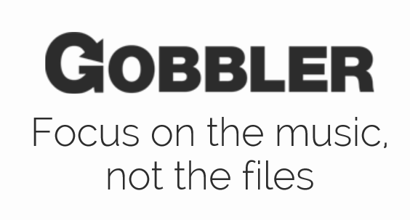




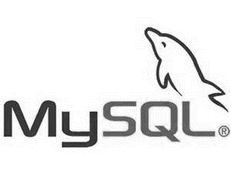








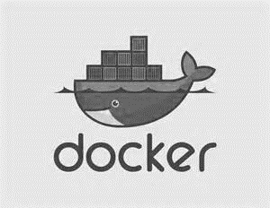
Support for Open Source
Languages
CMS
Devices
Databases / Apps
Operating
systems
Management

Slide 17
Trust through Transparency
$
Monthly SLAs
ISO 27001 Cloud Security Alliance (STAR)
Industry standards
Regulatory compliance
Trust center
Yearly audits
Independently verified
Real-time status
Service dashboard
HIPAA Business Associate Agreement (BAA)

Slide 18
Key Scenarios to Get Started with Microsoft Azure

Slide 19
Key Scenarios to get started with Microsoft Azure
Dev / Test
Full test and dev environments in minutes
VSO integration
Lift and Shift
Take existing work loads and run then in a certified instance
Storage
Archive key data in inexpensive cloud storage

Slide 20
Key Scenarios to get started with Microsoft Azure
Big Data
Process key data into business intelligence using Hadoop or Machine Learning
Identity
Synchronize all your identities through Azure AD to control access to Apps, Data and Services
Web Apps
Take your web apps to the cloud using inexpensive App Service Web Apps

Slide 21
Activate your MSDN Benefits…
+
3 VMs for 16 hrs a day
80 VMs for 20 hour load test
Up to 100 web sites + DB
Up to
$150
33%^{off}
25%^{off}
89
per Month
Dev/Test VMs
Other Dev/Test
Countries

Slide 22
Azure Services

Slide 23







Microsoft Azure Services
Office Add-in
PC
Tablet
Phone
Browser
Games console
On-premises service
On-premises database
Client layer
(on-premises)
Access Control
Layer
AD
Multifactor
Authentication
BizTalk Services
Service Bus
Logic Apps
Traffic Manager
Virtual Networks
Express Route
CDN
Integration
layer
API Mgmt
Mobile Apps
Web Apps
API Apps
VM
Media Services
Notification Hubs
Scheduler
Automation
Cloud Services
Application
layer
Blobs
Tables
Queues
SQL Database
Machine Learning
HD Insight
Caching
Backup and Recovery
StorSimple
Data Layer
Storage
Data

Slide 24
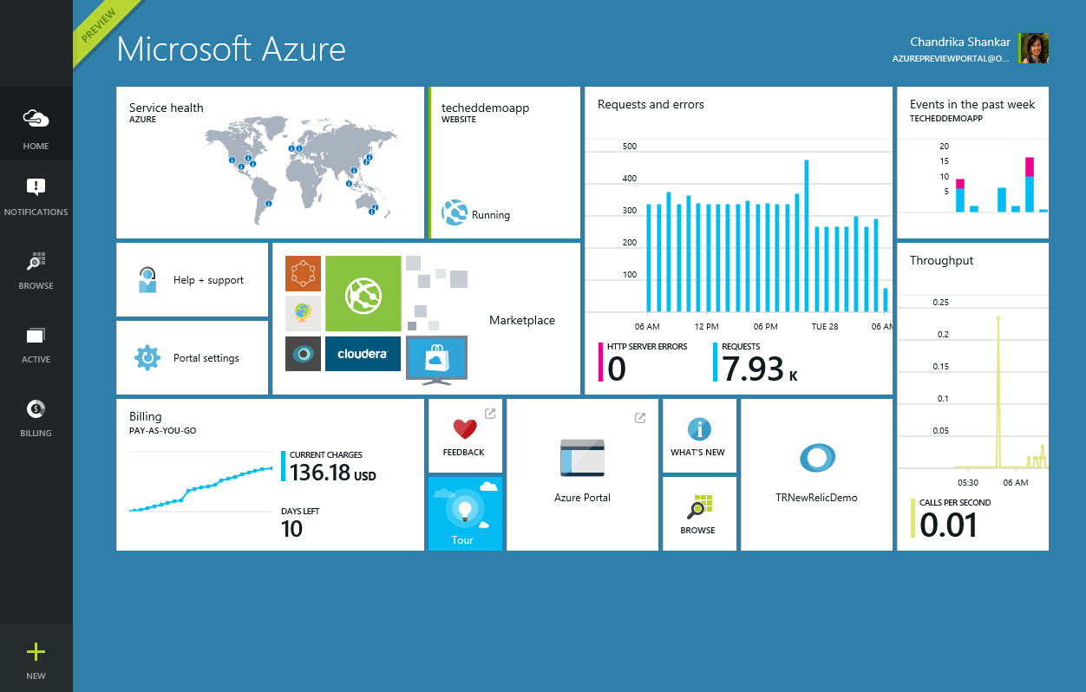
The Azure Preview Portal
Create and Configure Cloud Resources
Virtual Machines, Virtual Networks, Web Apps, Mobile Apps etc..
Monitor Workloads and Configure Alerts
Customizable Startboard and blades
Integrated DevOps Experience
Continuous integration and deployment and configuration management
Integration with the Azure Market Place
Easy access to Microsoft and Azure certified solutions

Slide 25
Demo: Azure Portal

Slide 26
Some Key Azure Features

Slide 27

Azure App Service
Integrated offering for building intelligent web and mobile apps
Web Apps – build web apps
Mobile Apps – build mobile apps for any device
Logic Apps – automate processes with durable cloud-based workflows
API Apps – build cloud APIs for Web/Mobile/Logic Apps to consume
Scale as your business grows
Connectors to common SaaS systems

Slide 28
Resource Group
container for multiple resources
resources exist in one* resource group
resource groups can span regions
resource groups can span services
RESOU
R
CE G
R
OUP
*and only one
Notes:
It’s a logical group
Manage and monitor a single resource group

Slide 29
Azure Virtual Machines
→ Launch Windows Server and Linux in minutes
→ Scale from 1 to 1000s of VM Instances
→ Save money with per-minute billing
→ Open and extensible
Notes:
Slide Objectives:
High-level selling points of virtual machines.
Speaker Notes:
Both Linux and Windows are supported. It’s important to reiterate on this as many developers are still not aware of this.
Mention scaling at enterprise level using DSC, Puppet or Chef.
Emphasize on the openness – we are not forcing your to lock on Microsoft technologies. Instead, Azure is more open than ever. You can leverage your existing skills, tools and services, and Azure is providing more and more first-class supports for them.

Slide 30
Virtual Machines
Getting started
Select image and VM size
New disk persisted in storage
Management portal
Windows Server
Boot VM from new disk
>_
Linux
Scripting
(Windows, Linux and Mac)
Blob Storage
General Purpose
Basic
Standard
Optimized Compute
Performance Optimized
Network Optimized
REST API
Cloud
Comprehensive
Networking
Notes:
Slide Objective:
Explain workflow for provisioning VMs in the cloud
Speaker Notes:
You have three methods of starting this process: Build a VM from the portal, from the command line OR programmatically calling the REST API.
Once your choice of provisioning is made you will need to select the image and instance size to start from.
The newly created disk will be stored in blob storage and your machine will boot.

Slide 31
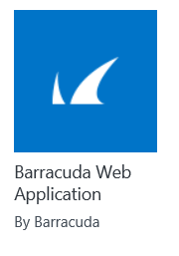
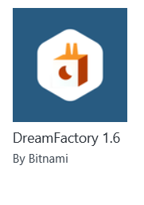
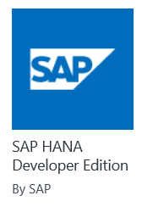
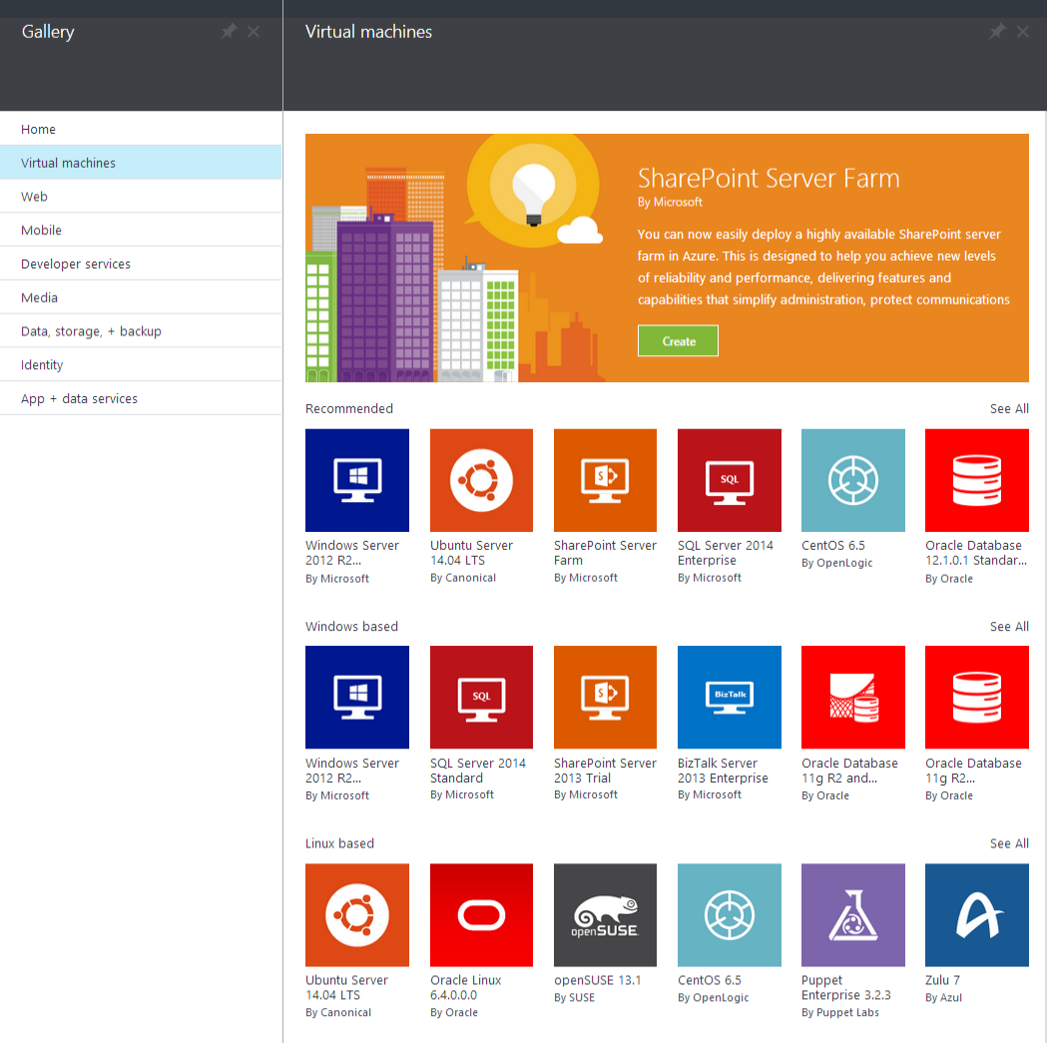
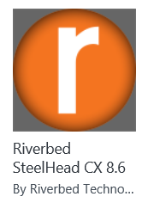
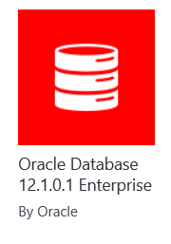
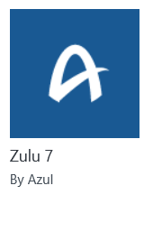
Microsoft Azure
Certified
Notes:
Slide Objective:
Explain a wide variety of images that you can choose from.
Speaker Notes:
First of all, you can choose from different Windows Servers and a variety of Linux implementations. [Click]
As well as pre-built images for different flavors of SQL Database and Oracle databases. [Click]
You can also choose from a number of first-party and certified third-party images for various application servers and infrastructural components. [Click]
And last but not least, if you are a MSDN subscriber, you also have access to Visual Studio images and client Windows systems such as Windows 7 and Windows 8.1 for your DevTest purposes.

Slide 32

Microsoft Azure Site Recovery Orchestrated disaster recovery to a second site or to Azure
Microsoft Azure Site Recovery
Microsoft Azure Site Recovery
Communication Channel
Communication and Replication
Replication channel: Hyper-V Replica
Windows Server
Primary Site
Recovery Site
Windows Server
Primary Site
Windows Server
Automated VM protection and replication
Remote health monitoring
Customizable recovery plans
No-impact recovery plan testing
Orchestrated recovery when needed

Slide 33

Titanfall
→ Game sessions hosted using Azure
→ Hosted using >100,000 Azure Virtual Machines
Notes:
Points to land:
Imagine what you could do…
→ 360,000 concurrent cores
→ Have EA tell the story
→ Assume we don't run out of capacity

Slide 34
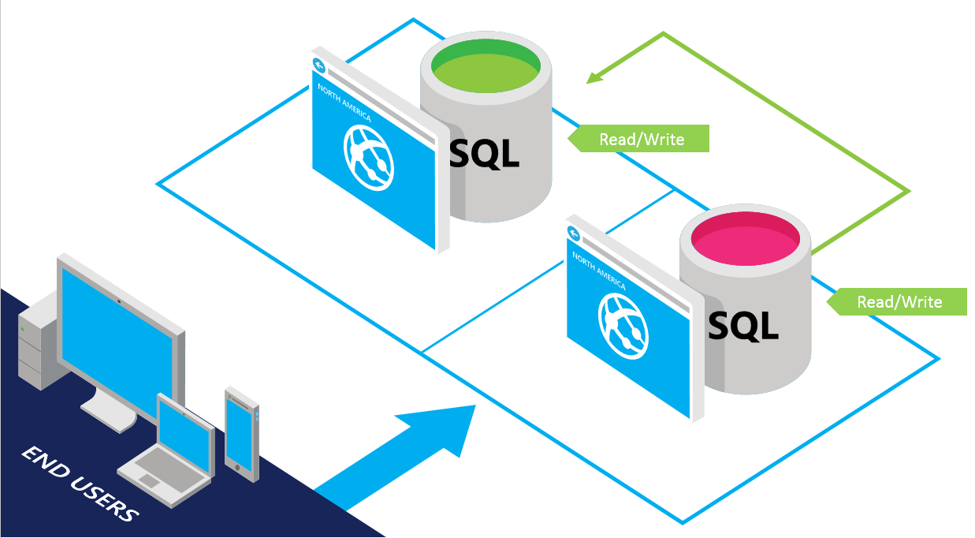
SQL Database
SQL Server database technology as a service
Fully Managed
Enterprise-ready with automatic support for HA
Designed to scale out elastically with demand
Ideal for simple and complex applications
Full support for TDS and ODBC
Familiar language and framework support
Cross Datacenter failover and backups to support disaster recovery scenarios

Slide 35

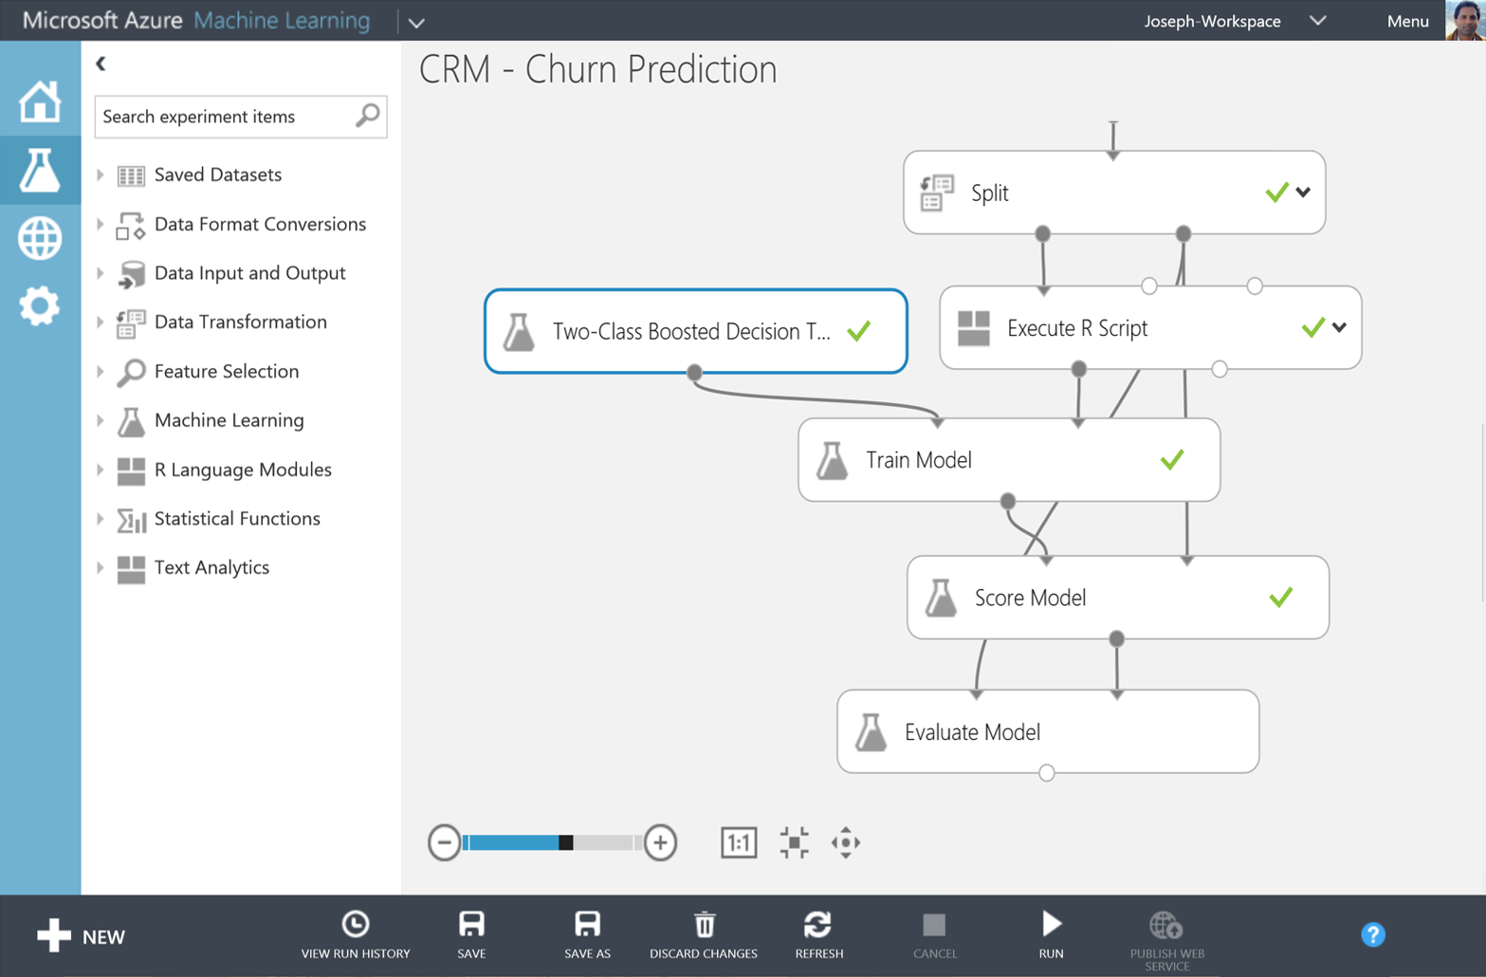
Big Data Insights
Microsoft Azure HDInsight
Microsoft Azure Machine Learning
Microsoft instance of Hadoop distribution running as service
Support existing ecosystem from Hive, Pig, etc
Extended to support Excel and BI tooling
Integration with diverse sources of data
Mashup sophisticated intelligent algorithms
Enables data scientists and developers to efficiently embed predictive analytics into their applications
Elastic, pay as you go with low operating costs
Extend with Power BI, Hadoop and cloud hosted data

Slide 36

Azure App Service
Preview
Web Apps
Mobile Apps
Web apps that scale with your business
Build Mobile apps for any device
LOGIC Apps
Api Apps
Automate business process across SaaS and on-premises
Easily build and consume APIs in the cloud
Notes:
App Service has everything you need to build apps that target both web and mobile clients from a single app back-end.
Using API Apps, you can connect your app to dozens of popular services like Office 365 and salesforce.com in minutes, and integrate your own APIs so they can be used within any app.
And finally with Logic Apps, you can automate business processes using a simple no-code experience.

Slide 37
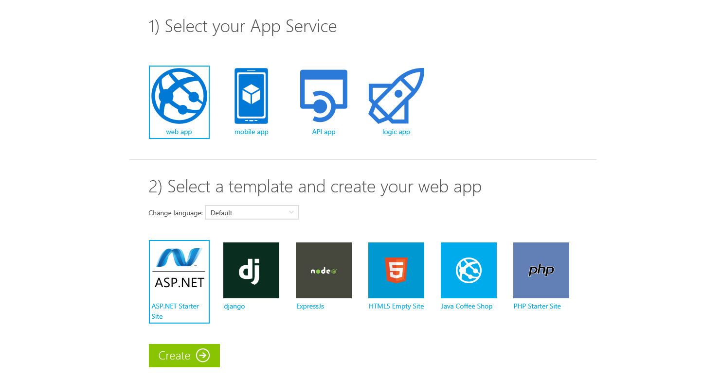
Try App Service Today
https://tryappservice.azure.com
Free
No Signup or Account Required

Slide 38



Azure App Service Web Apps
Start simple
Code smart
Go live
Create new sites in seconds
Easily manage and scale your sites
Automatic load balancing and shared storage across instances
Scale out or up to reserved instances for improved performance and scale
Built-in web jobs support
Use ASP.NET, ASP, PHP, Java, Node.js, Python
SQL Database or MySQL databases
Start with open source apps and frameworks
Develop with VS and WebMatrix
Supports any Web development tool on any platform (Windows, OSX, Linux)
Rapid deployment for quick iteration
Integrated source control with Team Foundation Server (TFS) and Git
Built-in monitoring of perf and usage data
Quick access to request logs, failed requests diagnostics and diagnostics
Office Blog ASP.NET site microsoft.com

Slide 39
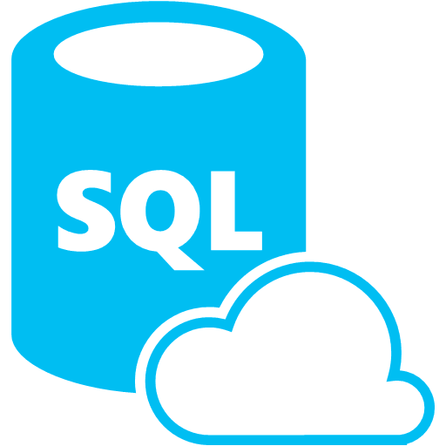






Azure App Service Mobile Apps
Provides essential services to support client development
Client Support
iOS
Android
HTML5/Web
Xamarin
Windows
Windows Phone
PhoneGap
Sencha
Storage
Authentication
Logic
Push
Scheduler
Notes:
Speaking Notes
Azure Mobile Services is a Backend-as-a-Service
Instead of you having to design, build, test, deploy, manage, and upgrade your whole backend, we do it for you
Features of Mobile Services
Storage – SQL DB
Authentication – built in support for social providers w/ ability to custom auth
Backend logic – data validation, logical flows, etc
Push Notifications – across all major mobile platforms
Scheduler – backend job processing

Slide 40
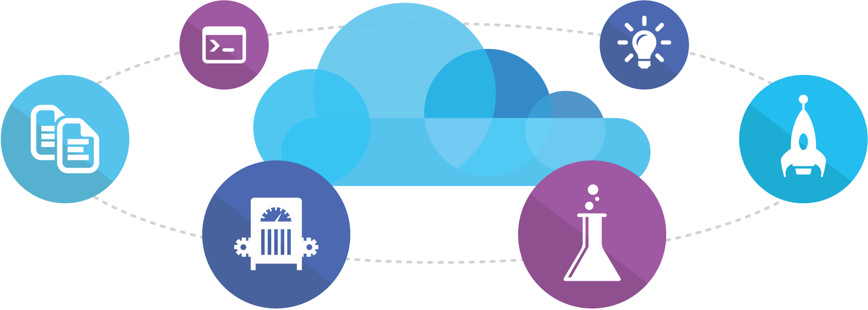
Visual Studio Online
Code
Insights
Agile
Deploy
Build
Test
Full Portal Integration
Not just for Microsoft shops

Slide 41
Demo: Azure Preview Portal

Slide 42
You
Microsoft Azure Active Directory
Synchronize your corporate and 3rd party identities
Integration with O365
Support modern protocols
OAuth 2.0
OpenID Connect
WS-Fed
SAML 2.0
Identity and Access Mgmt Permissions
Users
Groups
Applications
Microsoft Azure AD
3rd party clouds/hosting
PCs and devices

Slide 43

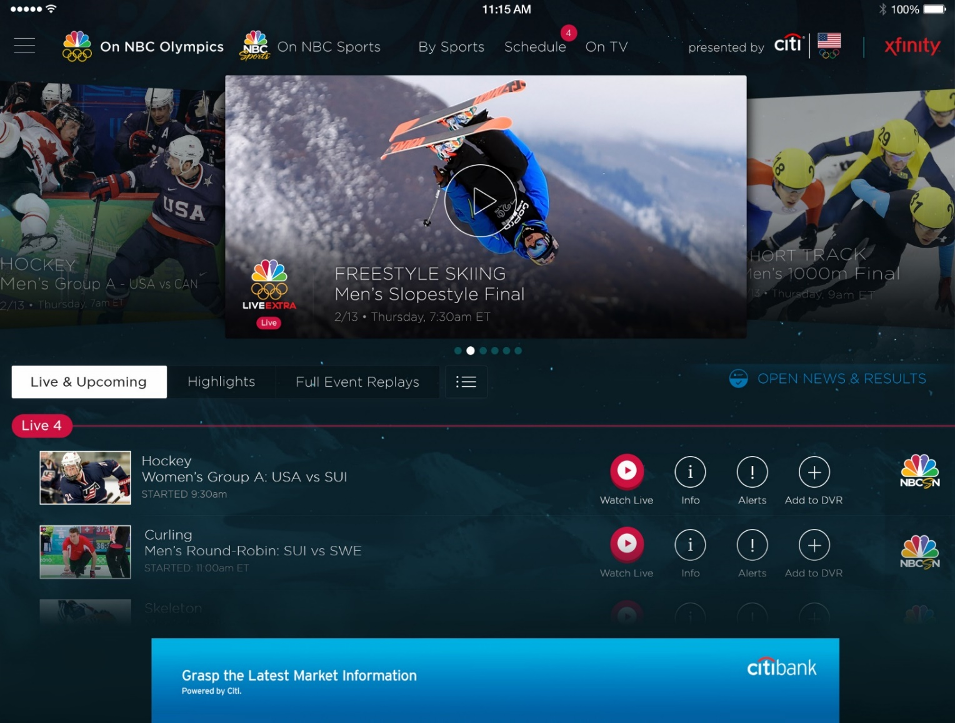
Azure Media Services
Olympics NBC Sports
On Demand Media Services
Video-on-demand
Ingest
Encode
Package
Encrypt
Delivery
Live Streaming Support
Office 365 Integration
Live video encoding and streaming
Web + Mobile
100 million viewers
2.1 million concurrent HD viewers during the USA vs. Canada hockey match

Slide 44

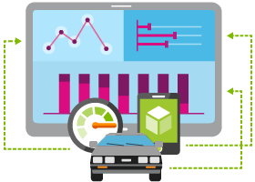





Internet of Things
Event Hubs
Notification Hubs
Stream Analytics
Machine Learning
HDInsight
Power BI for Office 365
With Microsoft Azure IoT services, you can monitor assets to improve efficiencies, drive operational performance to enable innovation, and leverage advance data analytics to transform your company with new business models and revenue streams.
Notes:
Speaking Notes
Azure Mobile Services is a Backend-as-a-Service
Instead of you having to design, build, test, deploy, manage, and upgrade your whole backend, we do it for you
Features of Mobile Services
Storage – SQL DB
Authentication – built in support for social providers w/ ability to custom auth
Backend logic – data validation, logical flows, etc
Push Notifications – across all major mobile platforms
Scheduler – backend job processing

Slide 45
Azure Data Factory
Compose and orchestrate
Connect to data of diverse shapes and location
Orchestrate processing to produce trusted data
Manage from single pane of glass
Manage a network of data pipelines
See lineage and impact analysis
Set data production policy
Retry, concurrency, late data handling
Identify and debug errors
Automatic dataset health alerts
Troubleshoot complex pipelines
AZURE DATA FACTORY
Manage and monitor
Data and operational lineage
Coordination and scheduling
Policy
DATA PIPELINES
Activity
Activity

Slide 46

Azure Stream Analytics
Event producers
Collection
Ingestor (broker)
Transformation
Long-term storage
Presentation and action
Stream Analytics
Web/thick client dashboards
Applications
Service bus
Legacy IOT (custom protocols)
Event hubs
Azure DBs
Stream processing
Search and query
Devices
Cloud gateways (web APIs)
Azure storage
IP-capable devices (Windows/Linux)
Storage adapters
HDInsight
Data analytics (Excel)
Low-power devices (RTOS)
Field gateways
Devices to take action

Slide 47
Activate your MSDN Benefits…
+
3 VMs for 16 hrs a day
80 VMs for 20 hour load test
Up to 100 web sites + DB
Up to
$150
33%^{off}
25%^{off}
89
per Month
Dev/Test VMs
Other Dev/Test
Countries

Slide 48
Thank you!
Vishesh Oberoi
Software Developer, Datacom
Email: vishesho@datacom.co.nz
Twitter: @ovishesh
http://visheshoberoi.com

Slide 49
Get started today at http://azure.microsoft.com

